Slide 1
Machine Translation & other tools for Indian languages
Tushar Abhishek

Slide 2
Table of Contents
Sentence and word tokenizers
Indian language tools
Script normalization
WordNet for Indian languages
POS tagger
Bilingual dictionary
Translation/Transliteration tools
API based
In document translation tools
Offline translation tools

Slide 3
Word and sentence tokenizer
There exists large set of libraries for word tokenization and sentences in Indian languages. Following are the popular one:
iNLTK
Indic_nlp_library
Stanza
We observed that stanza works better than other libraries.
Note: No one libraries support all the languages.

Slide 4
Word and sentence tokenizer (langauge support)
Stanza: supports only 4 languages: Hindi, Telugu, Tamil, Marathi.
iNLTK: supports 12 languages: Hindi, Bengali, Gujarati, Malayalam, Marathi, Tamil, Punjabi, Kannada, Oriya, Sanskrit, Nepali and Urdu.
Indic_nlp_tool: it also support 16 languages: Assamese, Bengali, Gujarati, Hindi, Kannada, Malayalam, Marathi, Odia, Punjabi, Tamil, Telugu, Urdu, English, etc.

Slide 5
Text Script normalization
Text written in Indic scripts display a lot of quirky behaviour on account of varying input methods, multiple representations for the same character, etc.
There is a need to canonicalize the representation of text so that NLP applications can handle the data in a consistent manner.
The canonicalization primarily handles the following issues:
Non-spacing characters like ZWJ/ZWNL
Multiple representations of Nukta based characters
Multiple representations of two part dependent vowel signs
Typing inconsistencies: e.g. use of pipe (|) for poorna virama
These are done using indic_nlp_tool, although it doesn’t support Urdu language. Once can use urduhack which has quite similar function definition as indic_nlp_tool and can be used directly.

Slide 6
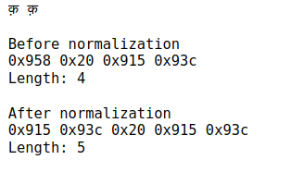
Text Script normalization

Slide 7
WordNet for Indian languages
WordNet are lexical knowledge bases that links words into semantic relations including synonyms, hyponyms, meronyms and many more.
These type of resource exists for high resource languages like English, French etc.
Although there is counterpart library that exists for Indian languages:
IndoWordNet
It support 18 different Indian language: Assamese, Bangla, Bodo, Gujarati, Hindi, Kannada, Kashmiri, Konkani, Malayalam, Meitei, Marathi, Nepali, Odia, Punjabi, Sanskrit, Tamil, etc.
One example for Hindi language: IndoWordNet

Slide 8
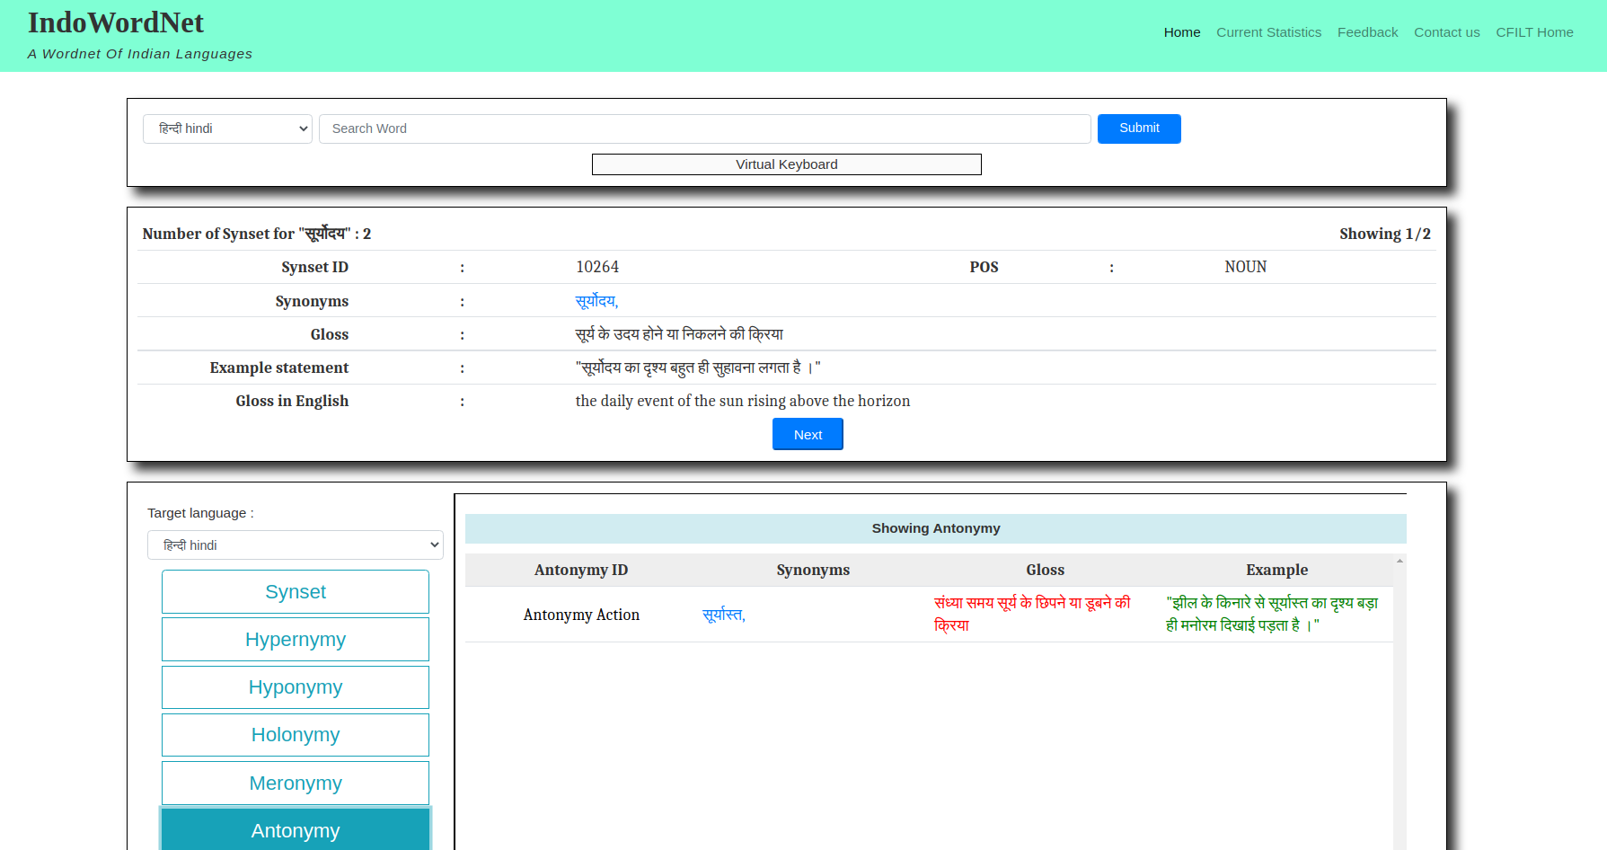
WordNet for Indian languages (why it's useful)

Slide 9
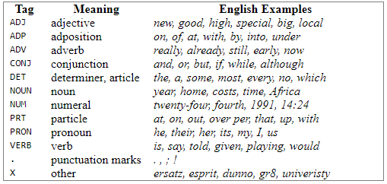
Part of Speech (POS) tagger
part-of-speech tagging (POS), also called grammatical tagging is the process of marking up a word in a text (corpus) as corresponding to a particular part of speech,[1] based on both its definition and its context.

Slide 10
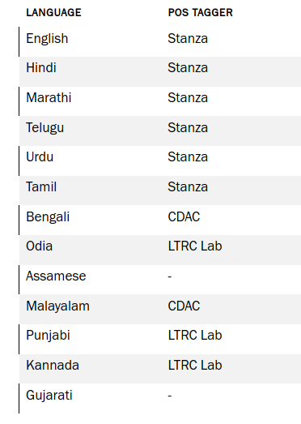
Part of Speech (POS) tagger (for Indian language)
We explored the open sourced POS tagger and found quite few Indian languages have POS tagger.
Stanza and CDAC returns quite accurate POS tags for the respective languages.
There also exists in-house (LTRC, IIIT Hyderabad) POS tagger for Odia, punjabi and Kannada

Slide 11
Translation/Transliteration Tools
Translation tool
Using APIs
One can use the Google APIs and Bing APIs call through python module to translate the text.
There is one catch, google and Bing caps the number of translation APIs calls (in terms number of characters, number of APIs calls, etc.)
In document translation tools
If someone wants quick translation of large number of words/sentence. One can use the google docs translation function. Example: translation example
Offline translation tools
These are large neural network model (usually transformer based models) and can be used to translate any number of sentences (there is no restrictions or cap).
Although running it on local machine can’t be feasible. You can use the google colab to translate the sentences.
One can use IndicTrans that support 12 Indian languages: Hindi, Bengali, Gujarati, Malayalam, Marathi, Tamil, Punjabi, Kannada, Oriya, Sanskrit, Nepali.
google colab notebook

